Slide 1
React

Slide 2
What is React Js?
ans: React is a User Interface library, it is used for building user interfaces , particularly for single-page
Application.
Example:
import React from ‘react’;
Import React Dom from ‘react-dom’;
Class hello extends React,component{
Render(){
Return <h1>hello</h1>
}}
React dom.render (<hello name=“world”>
Document.getElementById(‘root’)
);
2. What is NPM in React Js?
ans: NPM in react js is used for the node package manager.
NPM is commonly used to install React and its related dependencies, manage project dependencies, and run scripts.

Slide 3
3. What is the role of node js in react js ?
And: node js is used when React renders components on the frontend, while Node. js manages server-side data communication. The synergy between React and Node. js creates a cohesive and responsive web application. It is commonly used for setting up development servers, building tools, and running scripts in React.js projects.
4. . What is CLI command In React Js?
Ans:CLI stands for Command Line Interface. In React.js, the CLI command usually refers to the commands provided by tools like Create React App, which is a popular toolchain for building React applications. These commands allow developers to create, build, and manage React projects through the command line.
5. What are Components in React Js?
Ans: They are reusable and independent pieces of UI that can be composed together to build complex user interfaces. Components can be either functional or class-based and encapsulate both the structure and behavior of a UI element.
6. What are Header and Content Components in React Js?
Ans: Header and Content components are examples of components in a React.js application. The Header component might contain the navigation bar or branding elements, while the Content component could display the main content of the application

Slide 4
7. How to install React Js on Windows, Linux Operating System? How to Install NPM and How to check the version of NPM?
Ans: To install React.js on Windows, Linux, or any other operating system, you can use Node Package Manager. First, ensure you have Node.js installed. Then, you can install React.js using the following command.
bash
npm install -g create-react-app
```
To install NPM, you typically install Node.js, and NPM comes bundled with it. To check the version of NPM, you can run:
```bash
npm -v

Slide 5
8. How to check the version of React Js?
Ans: step 1:go to package.json
Step 2:then go to command prompt or terminal and write “npm react version”
Then it can show the current version of react js .
9. How to change components of React Js?
To change components in React.js, you typically edit the JSX files where the components are defined. You can modify the structure and behavior of components by editing their code directly.

Slide 6
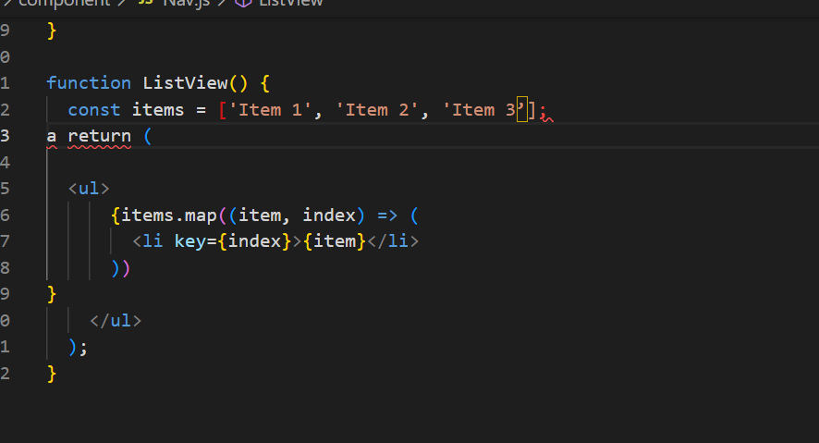
10. How to Create a List View in React Js?
To create a list view in React.js, you can use the `map()` function to iterate over an array of data and render a list of items. Here's a simple example:
import React from 'react';

Slide 7
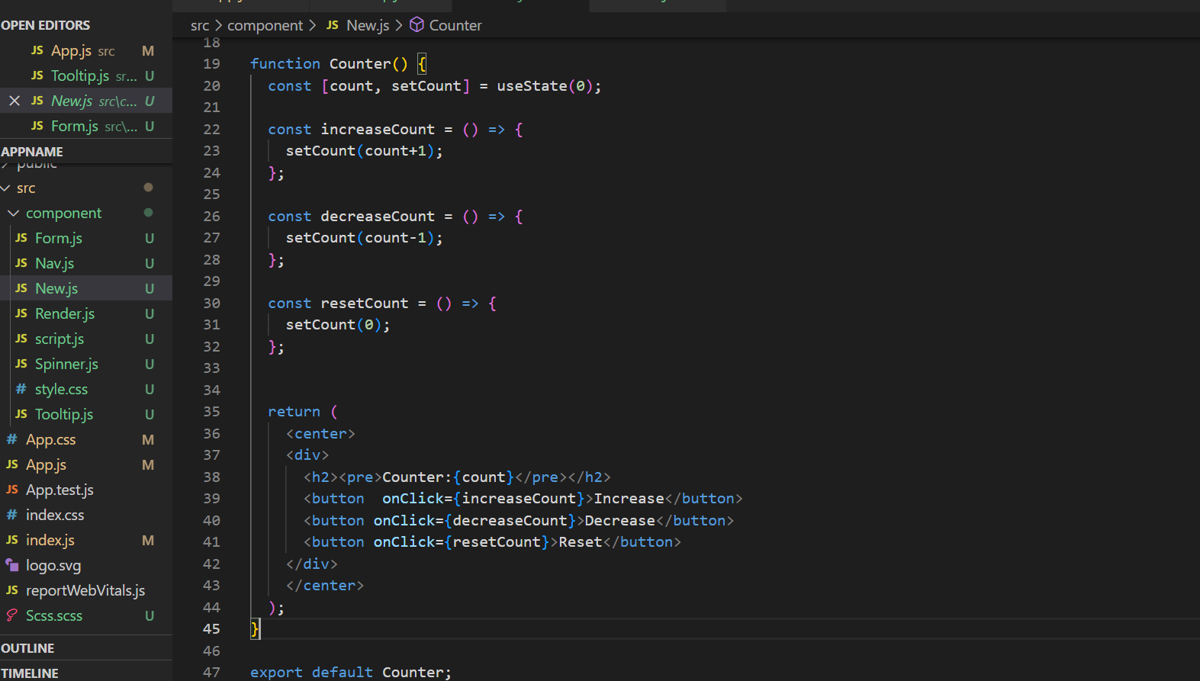
11.Create Increment decrement state change by button click?
Ans:

